Slide 1


Trong Pham
Oct 7th 2023

Slide 2

Outline
Executive Summary
Introduction
Methodology
Results
Conclusion
Appendix

Slide 3
Executive Summary
ETL process on SPACEX project before predicting risk of landing ships per case
Extract data from Wikipedia.SPACEX (Request.GET and Beautiful Soup.find)
Visualizing data on local host webpage with multiple filter factors (ships, landing site, mass size)
Transforming data with better categories (success class (0,1))
Splitting data to test and train data-subset before applying multiple ML model to predict (KNN, SVM, Logistic Regression)
Turning out the full prediction scales with multiple predicting models, top choice of

Slide 4
Introduction
Providing that SPACEX has goal of cutting landing cost by reuse those ship. This project is aim for predicting the success lading rate for each time and thus help SPACEX and other businesses get more insight of future tries
The question is what and how to predict the landing success rate for those ships base on given data of those previous trials

Slide 5

Section 1

Slide 6
Methodology
Executive Summary
Data collection methodology:
Understand the SPACEX REST API provided from api.spacexdata.com/v4/
Study the open-web-source Wikipedia for better understanding data’s type and structure
Perform data wrangling
Using the requests library with get method to obtain data package
Using bs4.BeautifulSoup to break data down to smaller data chunks with better structure
Perform exploratory data analysis (EDA) using visualization and SQL
Perform interactive visual analytics using Folium and Plotly Dash
Perform predictive analysis using classification models
Using GridSearchCV on structured-normalized dataset for better evaluate the factors affect outcome then configuring different ML predicting models and utilize score and best_params_ to evaluate models’ efficiency.

Slide 7
Data Collection
This is the first step of project:
Data is collect through wikipedia webpage of SPACEX landing trials
To collect data, we need to understand the SPACEX API of how data is structured
Applying data scrapping techniques to obtain data and put them in data frames for later usages
Data collection flow:
Define data source —> Understand how data is structured —> Extract data and organize them

Slide 8
Data Collection – SpaceX API
Data: SPACE X Data Source link
Data API structure link
Project link: GitHub link
Capsules
SPACEX v4 data structure
Core
Launch
What we need!!!

Slide 9
Data Collection - Scraping
Data: SPACE X Data Source link
Project link: GitHub link
data
1.request.get
2.BeautifulSoup
soup
1.HTML tags find
2.dataframing
structured dataset

Slide 10
Data Wrangling
Data is processed through EDA and features engineering
EDA: use Seaborn library to explore and discover data relationship through different type of bar, line, box, scatter, cat plots
Engineered features of flight-number, payload mass, orbit… before applying dummy variable for better standardize data for analyzing later in visualization
Data Wrangling flow of:
Data EDA —> Data features’ engineering —> Data finalizing
Data WrangliNG project: GitHub Link

Slide 11
EDA with Data Visualization
EDA is a long list of connection finding among features
Successful rate on connection of
Flight Number ft. Pay load mass (cat plot)
Flight Number ft. Launch site (cat plot)
PayloadMass ft. Launch site (scatter plot)
Successful rate on different type of orbits (bar plot)
Successful rate on yearly record (line plot)
Data EDA GitHub URL

Slide 12
EDA with SQL
List down all landing sites (task 1)
List down data that matches extra condition (task 2,3,4)
Define the first date of successful landing (task 5)
Look for the booster version match specific condition (task 6)
Count of all landing outcomes(success and failures) (task 7)
What is the maximum payload mass (task 8)
When did the failures in 2015 ? (Task 9) or specific extra condition (task 10)
GitHub URL

Slide 13
Build an Interactive Map with Folium
Mark location of all launch sites
Add and mark the location of NASA Johnson Space Center at Houston, TX
List out all launching sites, mark them as names and markers on the map to prove that all sites are closed to coast
List out all launching times as marker clusters to show marker groups on the map
Add mouse marker functions to the map
Add distance function to measure distance among 2 points on the map
Use the built-up distance measuring function to show distance and draw lines among them
IBM Watson URL (GitHub Link required trust rights from File > Trust Notebook)

Slide 14
Build a Dashboard with Plotly Dash
There is two main type of reports:
One for success rate for all sites or a selected site
One for success rate per payload mass and classified deeper with Booster Version
There is a range slicer of payload mass, base on that selected range, the second report will filter out the corresponding payload mass to show respectively outcome per Booster Version
GitHub URL

Slide 15
Predictive Analysis (Classification)
This part help to predict the outcome of landing process base on history of landing times
The process is:
Define models’ parameters of KNN, SVM, Logistic Regression
Select the best factor per model by GridSearchCV
Split data to test and train set
Apply different models to evaluate best fit model by score and parameters
GitHub URL

Slide 16
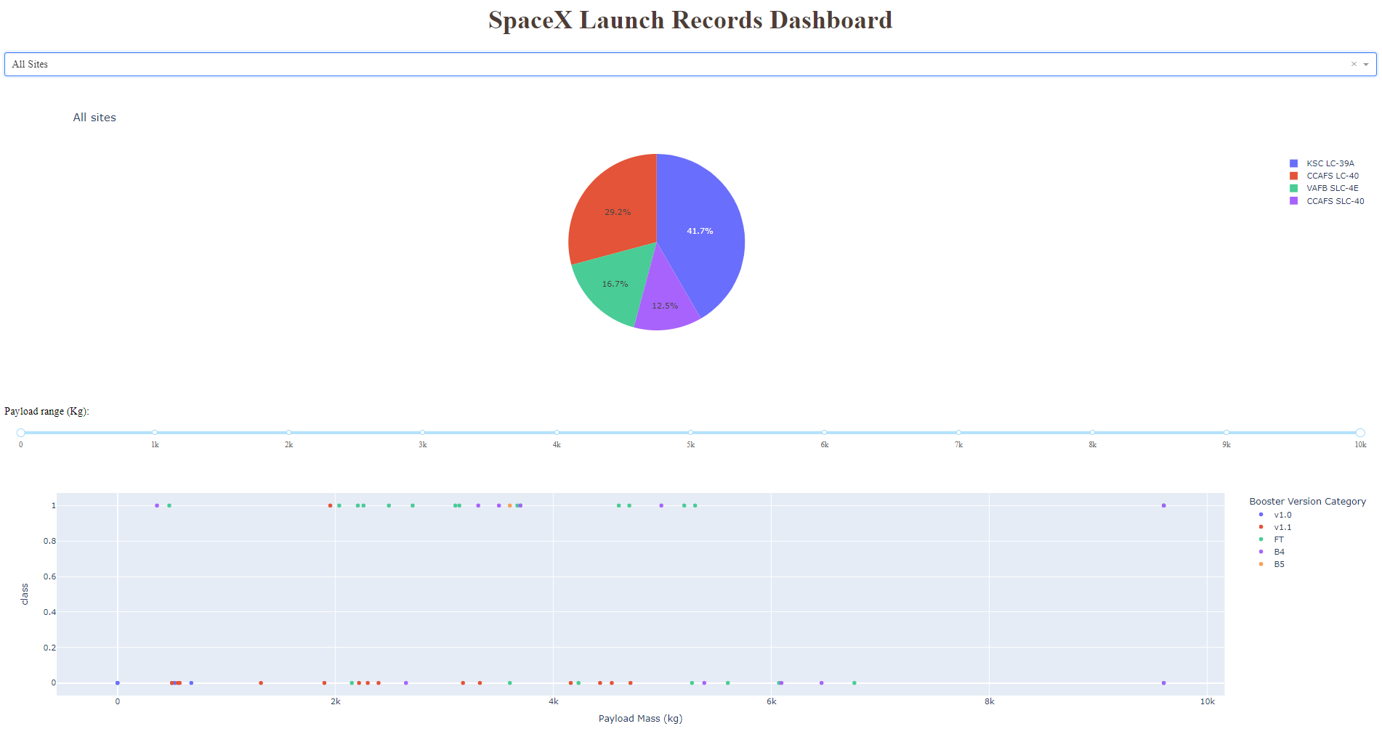
Results
Exploratory data analysis results
VAFB site, VLEO orbit has highest success rate
Interactive analytics screenshots
Predictive analysis results
SVM decision tree has the highest fit score @ 90.5% correctness

Slide 17

Section 2

Slide 18
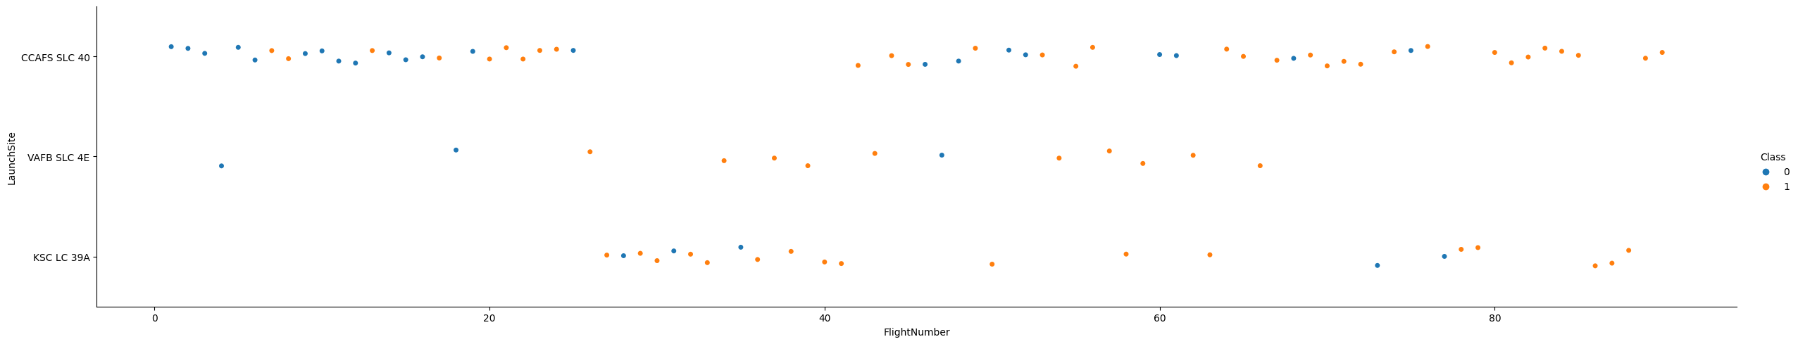
Flight Number vs. Launch Site
Show a scatter plot of Flight Number vs. Launch Site
KSC LC 39A has the best success rate

Slide 19
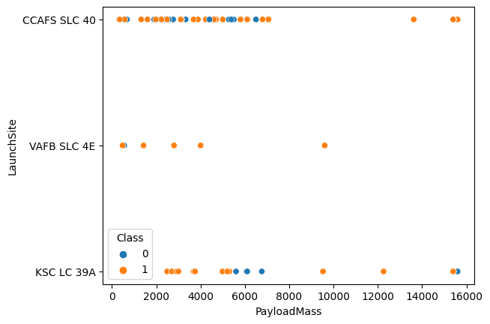
Payload vs. Launch Site
Show a scatter plot of Payload vs. Launch Site
VAFB SLC 4E site success at most of payloadmass under 10,000 kg

Slide 20
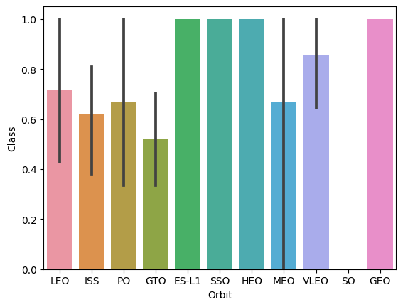
Success Rate vs. Orbit Type
Show a bar chart for the success rate of each orbit type
ES-L1, SSO, HEO, GEO have the highest success rate

Slide 21
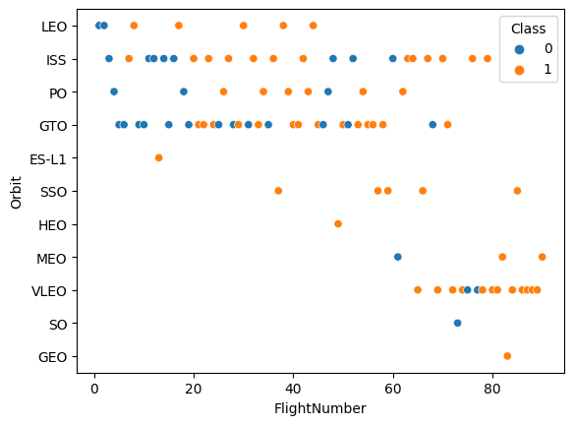
Flight Number vs. Orbit Type
Show a scatter point of Flight number vs. Orbit type
In the group of highest success rate:ESL1, SSO, HEO, VLEO, GEO, VLEO has highest flight counts

Slide 22
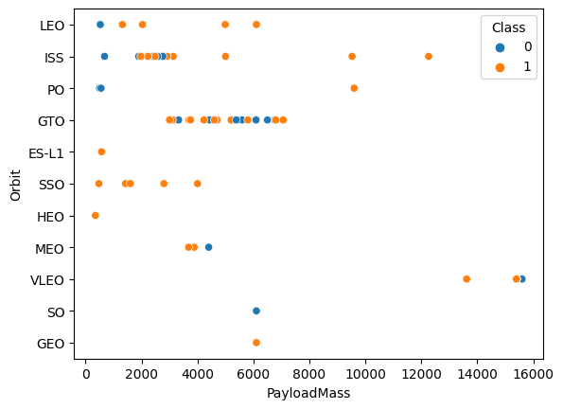
Payload vs. Orbit Type
Show a scatter point of payload vs. orbit type
With higher mass of payload, success rate increase, especially over 10,000 kg of mass

Slide 23
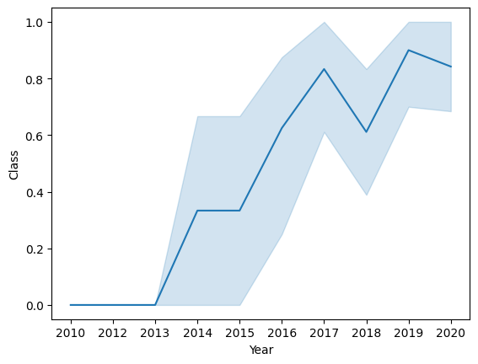
Launch Success Yearly Trend
Show a line chart of yearly average success rate
Since 2013, there is increment in success rate, top notch @ 2017 and 2019

Slide 24
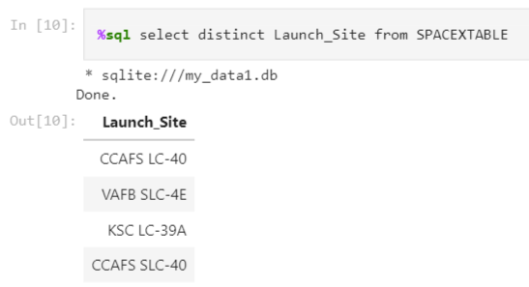
All Launch Site Names
Find the names of the unique launch sites
There is actually 4 sites

Slide 25
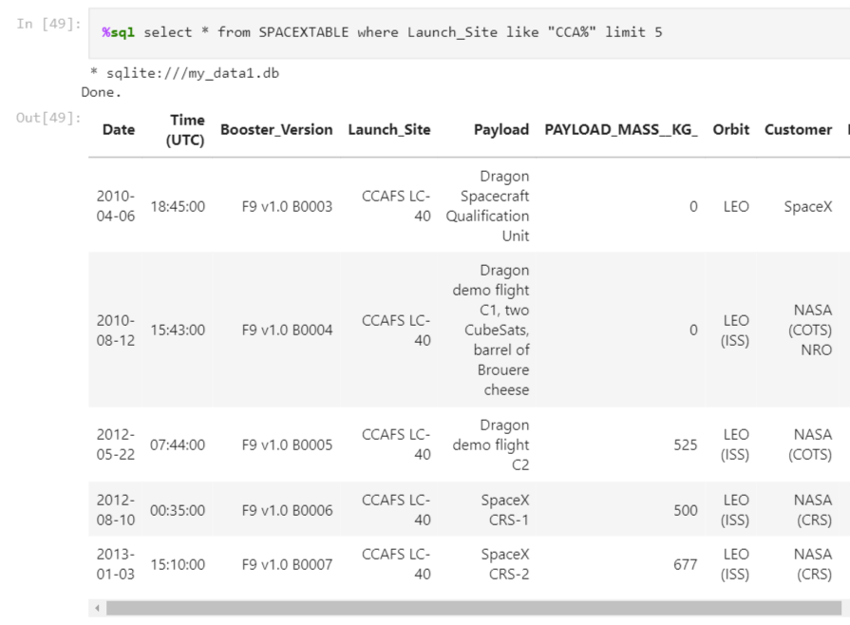
Launch Site Names Begin with 'CCA'
Find 5 records where launch sites begin with `CCA`
The first CCA site was on 2010-04-06

Slide 26
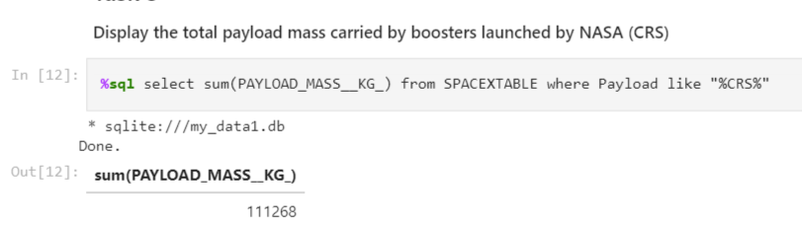
Total Payload Mass
Calculate the total payload carried by boosters from NASA
The total payload carried by NASA boosters is 111,268 kg

Slide 27
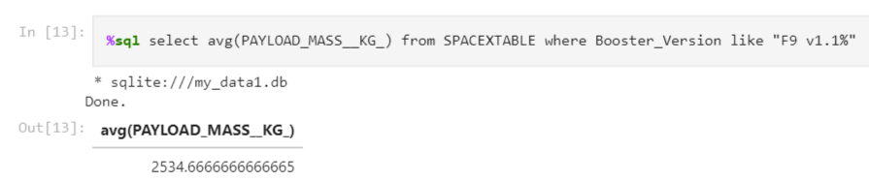
Average Payload Mass by F9 v1.1
Calculate the average payload mass carried by booster version F9 v1.1
The average mass carried by F9 v1.1 is 2534.7 kg

Slide 28
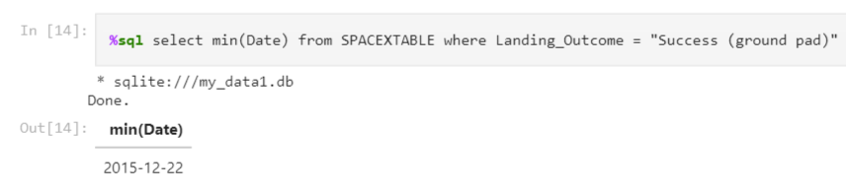
First Successful Ground Landing Date
Find the dates of the first successful landing outcome on ground pad
First success landing on group pad is 2015-12-22

Slide 29
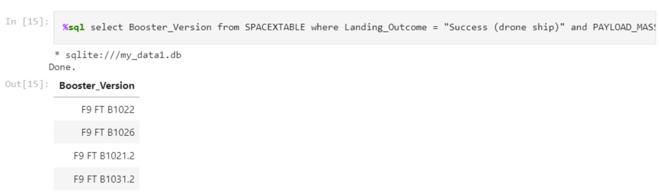
Successful Drone Ship Landing with Payload between 4000 and 6000
List the names of boosters which have successfully landed on drone ship and had payload mass greater than 4000 but less than 6000
Those booster met requirements are F9 FT B102x series shown above

Slide 30
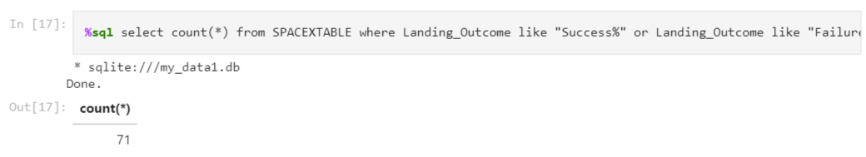
Total Number of Successful and Failure Mission Outcomes
Calculate the total number of successful and failure mission outcomes
There is total 71 missions of success and failures

Slide 31
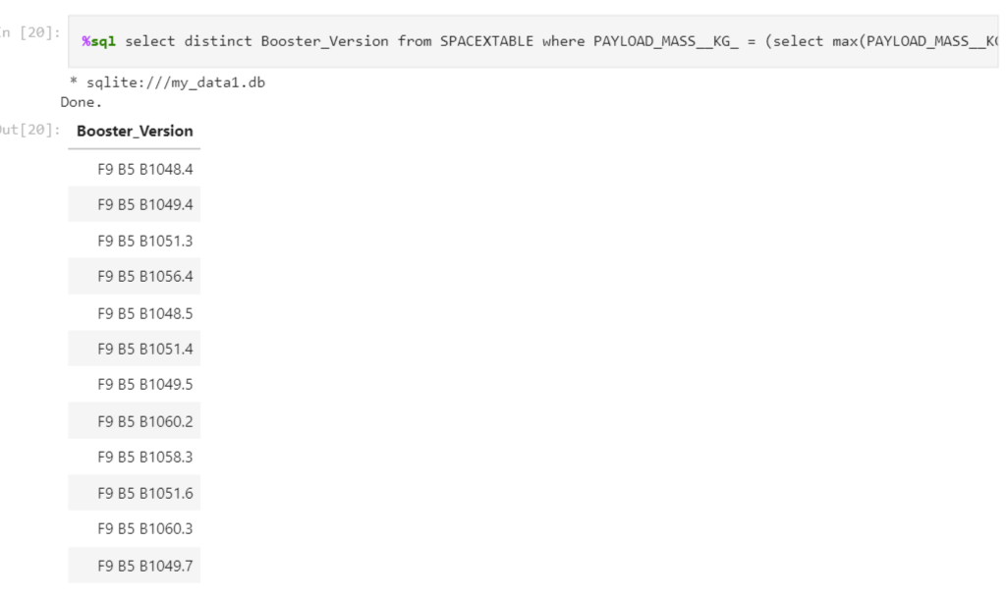
Boosters Carried Maximum Payload
List the names of the booster which have carried the maximum payload mass
That is a long list of boosters of F9 B5 B104, 105, 106 series

Slide 32
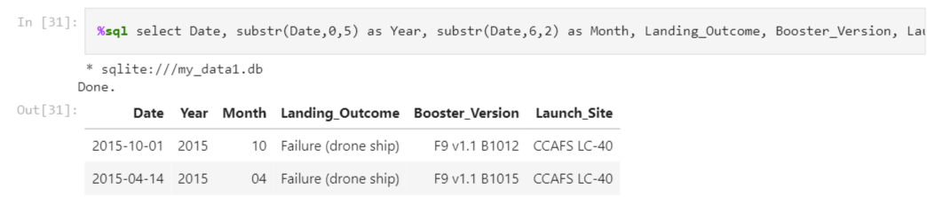
2015 Launch Records
List the failed landing outcomes in drone ship, their booster versions, and launch site names for in year 2015
They are F9 v1.1 B1012 and B1015

Slide 33
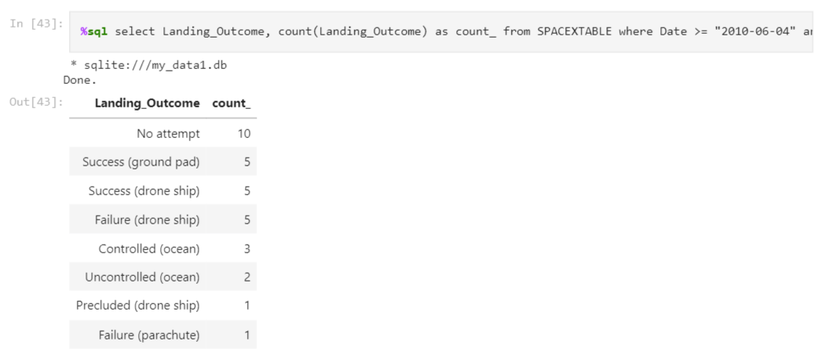
Rank Landing Outcomes Between 2010-06-04 and 2017-03-20
Rank the count of landing outcomes (such as Failure (drone ship) or Success (ground pad)) between the date 2010-06-04 and 2017-03-20, in descending order
There is an outcome list classifying as above as (10,5,5,5,3,2,1,1)

Slide 34

Section 3

Slide 35
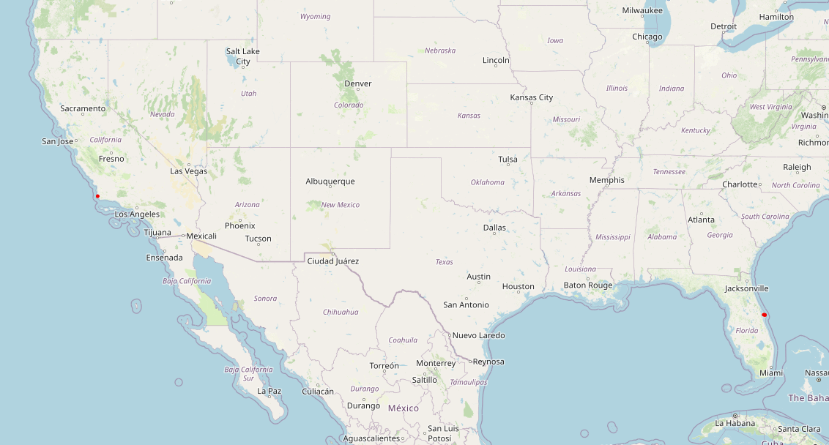
All Launching Sites
All launching sites are located on both coast sides as 2 red markers

Slide 36
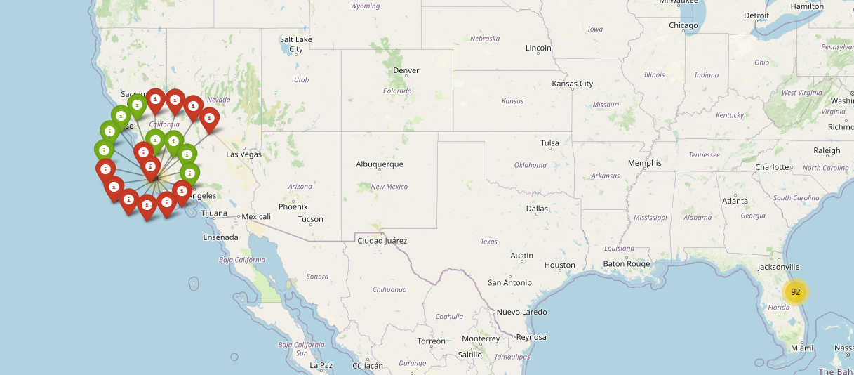
Landing outcomes at site groups
There are 2 marker clusters for both main group of sites, each has 2 outcome coloring as blue and red tags

Slide 37
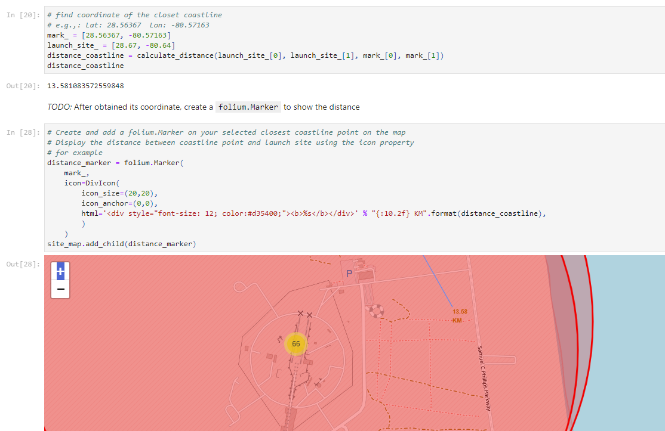
Distance measurement
Given 2 points, 1 from the resident area, another in ocean, the measured distance as shown as 13.58 km

Slide 38

Section 4

Slide 39
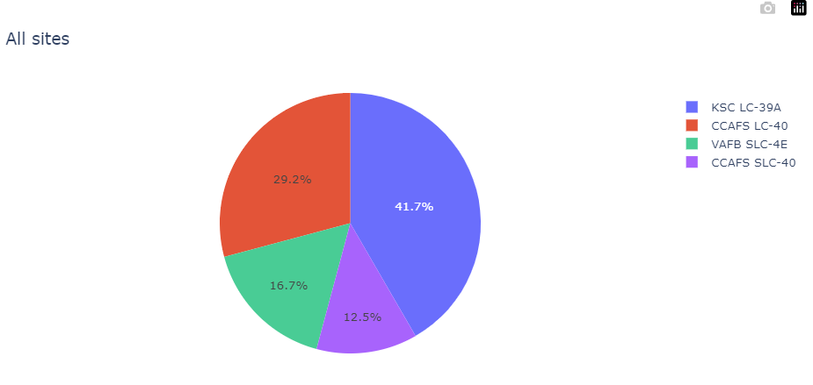
launch success count for all sites
Show the screenshot of launch success count for all sites, in a piechart
KSC LC-39A has the highest success rate and counts

Slide 40
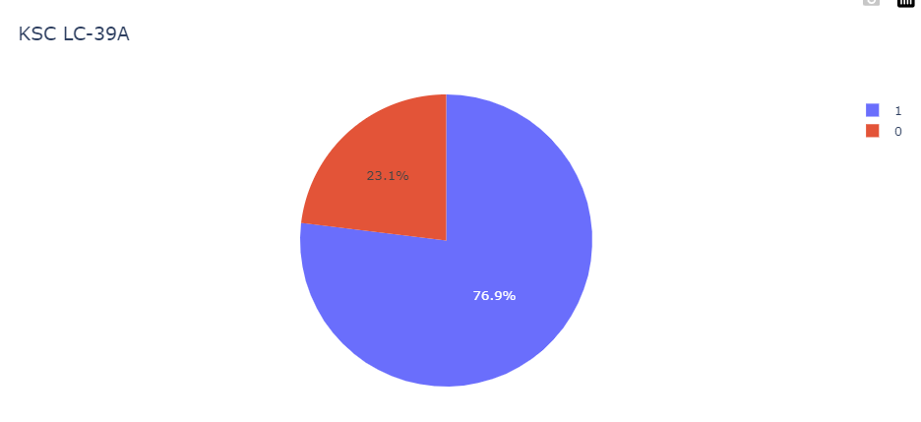
launch site with highest launch success ratio
KSC LC-39A has 76.9% of success rates

Slide 41
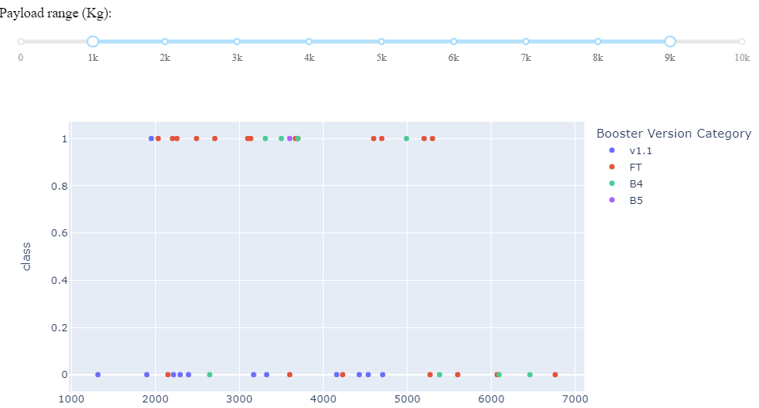
Payload vs. Launch Outcome for all sites
Within the range of payload from 1k to 9k, there is an inequal distribution of success rates on booster versions

Slide 42

Section 5

Slide 43
Classification Accuracy
Model has the highest classification accuracy is the Decision Tree Model with score of 90.5% (testing set) and accuracy of 83.3% (training set)

Slide 44
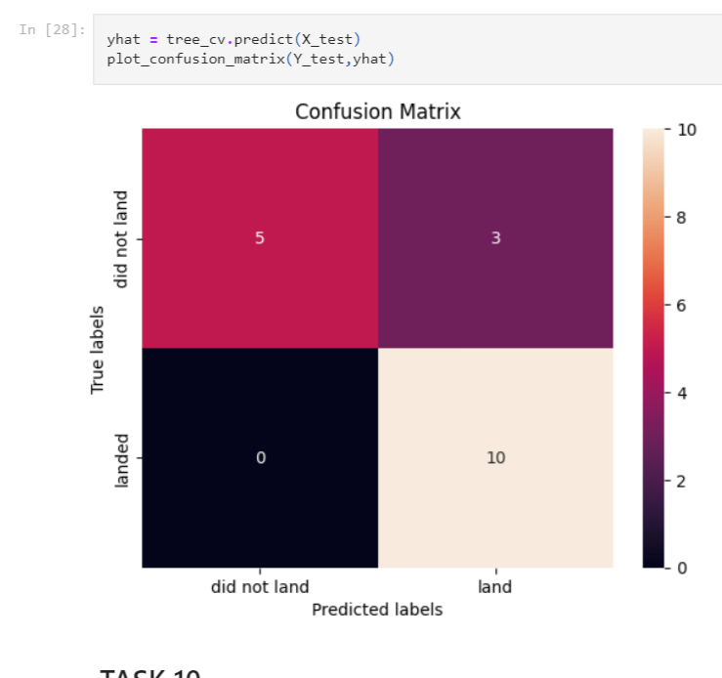
Confusion Matrix
With the highest rate of un/expected and predicted outcome, this Decision Tree is the best fit model in this use case

Slide 45
Conclusions
The total payload carried by NASA boosters is 111,268 kg
There is total 71 missions of success and failures of Falcon 9 project
KSC LC-39A has the highest success rate and counts
Decision Tree is the best fit model to predict in this use case

Slide 46
Appendix
All GitHub code of working project
Extra visualization part (GitHub link)
Supportive tasks of Python, Seaborn, Dash, Plotly, NumPy, Matplotlib, SQL Alchemy
Strongly thanks to IBM Professional Training Group
Best thank to Coursera

Slide 47


